Slide 1
Light Gradient Boosting (LightGBM)

Slide 2
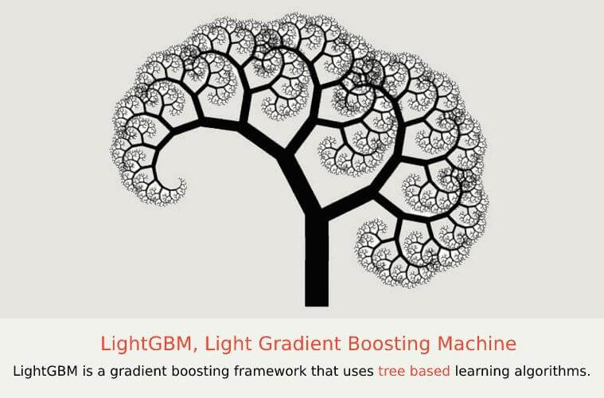

Slide 3
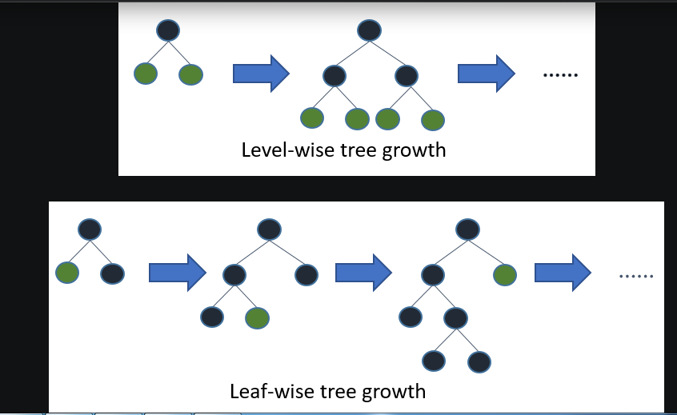

Slide 4
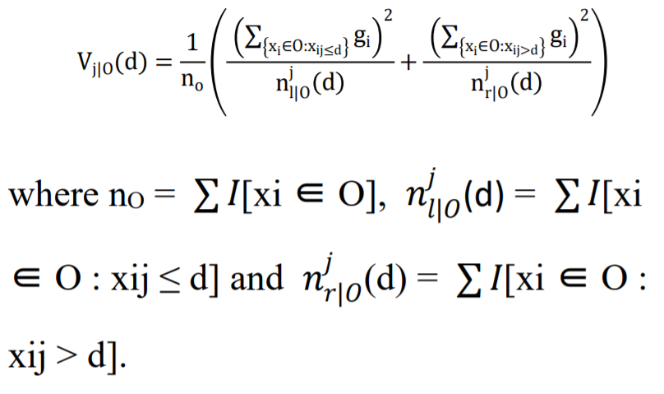
“Y=Base_tree(X)-lr*Tree1(X)-lr*Tree2(X)-lr*Tree3(X)” Explanation, Let O be a training dataset on a fixed node of a decision tree and then the variance gain of dividing measure j at a point d for a node is defined as

Slide 5
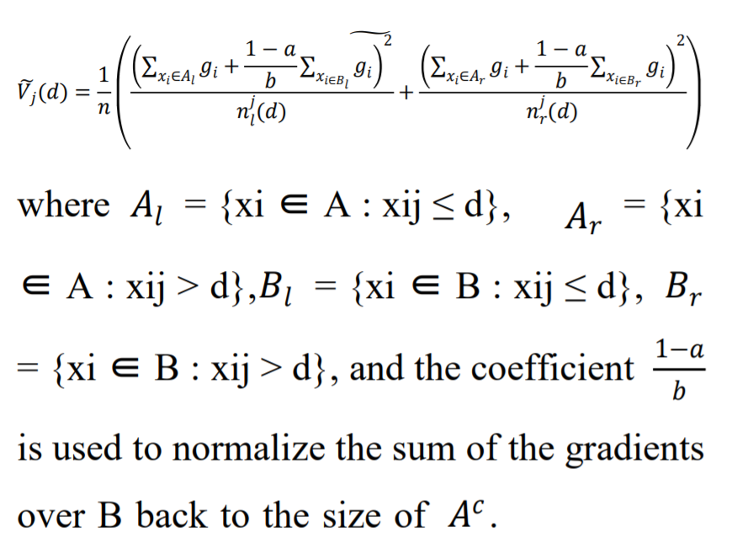

Slide 6
